Slide 1
Mehran S. Fallah April 2020
Programming Languages
Session III
Attribute Grammars

Slide 2
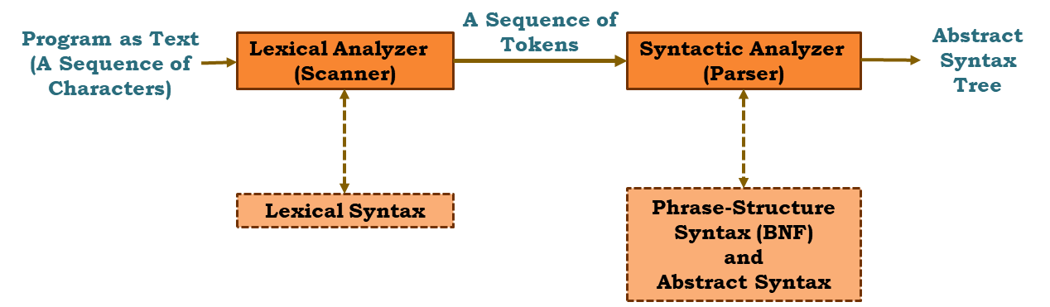


Introduction
We have seen some syntactic processes of a program.
The AST obtained from the process above may not represent a well-formed program. It is due to the context conditions that cannot, or are not practical to, be tested using a context-free grammar.
Although we can give context-sensitive grammars, these grammars in general are impractical for specifying the context conditions for a programming language.
In this session we investigate a different technique for augmenting a context-free grammar in order to verify context-sensitive conditions.

Slide 3
Introduction (Ctd.)
Attribute grammars can perform several useful functions in specifying the syntax and semantics of a programming language.
An attribute grammar can be used to specify the context-sensitive aspects of the syntax of a language, such as checking that an item has been declared and that the use of the item is consistent with its declaration.
Attribute grammars can also be used in specifying an operational semantics of a programming language by defining a translation into lower-level code based on a specific machine architecture.
Attribute grammars were first developed by Donald Knuth in 1968 as a means of formalizing the semantics of a context-free language. Since their primary application has been in compiler writing, they are a tool mostly used by programming language implementers.
We first use some examples to introduce attribute grammars.
We then provide a formal definition for an attribute grammar followed by additional examples.

Slide 4
Concepts and Examples
An attribute grammar may be informally defined as a context-free grammar that has been extended to provide context sensitivity using a set of attributes, assignment of attribute values, evaluation rules, and conditions.
A finite, possibly empty set of attributes is associated with each distinct symbol in the grammar. Each attribute has an associated domain of values, such as integers, character and string values, or more complex structures.
Viewing the input sentence (or program) as a parse tree, attribute grammars can pass values from a node to its parent, using a synthesized attribute, or from the current node to a child, using an inherited attribute. In addition to passing attribute values up or down the parse tree, the attribute values may be assigned, modified, and checked at any node in the derivation tree.
As an example, we will attempt to write a grammar to recognize sentences of the form a^{n}b^{n}c^{n}. The sentences aaabbbccc and abc belong to this grammar, whereas aaabbbbcc and aabbbcc do not. A first attempt to describe the language using a context-free grammar is:

Slide 5
Concepts and Examples (Ctd.)
This grammar can generate the string aaabbbccc. It can also generate the string aaabbbbcc.
It is impossible to write a context-free grammar for this language.
aaabbbccc
aaabbbbccc

Slide 6
Concepts and Examples (Ctd.)
If we augment our grammar with an attribute describing the length of a letter sequence, we can use these values to ensure that the sequences of a’s, b’s, and c’s all have the same length. The first solution involves a synthesized attribute Size that is associated with the nonterminals <asequence>, <bsequence>, and <csequence>. We add the condition that, at the root of the tree.
If a character sequence consists of a single character, Size is set to 1; if it consists of a character sequence followed by a single character, Size for the parent character sequence is the Size of the child character sequence plus one.

Slide 7
Concepts and Examples (Ctd.)
This attribute grammar successfully parses the sequence aaabbbccc since the sequence obeys the BNF and satisfies all conditions in the attribute grammar.

Slide 8
Concepts and Examples (Ctd.)
On the other hand, this attribute grammar cannot parse the sequence aaabbbbcc . Although this sequence satisfies the BNF part of the grammar, it does not satisfy the condition required of the attribute values.

Slide 9
Concepts and Examples (Ctd.)
Reconsider the problem of recognizing sequences of the form a^{n}b^{n}c^{n}. We use the attribute Size as a synthesized attribute for the sequence of a’s and InhSize as inherited attributes for the sequences of b’s and c’s. As we have already seen, we can synthesize the size of the sequence of a’s to the root of the parse tree. In this solution we set the InhSize attribute for the b sequence and the c sequence to this value and inherit it down the tree, decrementing the value by one every time we see another character in the sequence.

Slide 10
Concepts and Examples (Ctd.)

Slide 11


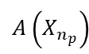


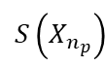








Attribute Grammars: Formal Definitions
$$A\left(X_{0}\right)$$
$$I\left(X_{0}\right)$$
X₀
$$Atb∈S\left(X_{0}\right)$$
$$S\left(X_{0}\right)$$
…
…
X₁
X_{k}
X_{np}
$$A\left(X_{1}\right)$$
$$A\left(X_{k}\right)$$
$$A\left(X_{n_{p}}\right)$$
$$I\left(X_{1}\right)$$
…
$$I\left(X_{k}\right)$$
…
$$I\left(X_{n_{p}}\right)$$
$$S\left(X_{1}\right)$$
$$S\left(X_{k}\right)$$
$$S\left(X_{n_{p}}\right)$$
$$Atb∈I\left(X_{k}\right)$$

Slide 12
Semantics via Attribute Grammars: An Example
We develop the semantics of binary numerals. A binary numeral is a sequence such as 100.001 and 0.001101. For simplicity, we require at least one binary digit, which may be 0, for each sequence of binary digits. We define the semantics of a binary numeral to be the real number value Val associated with the numeral, expressed in base-ten notation. For example, the semantics of the numeral 100.001 is 4.125.

Slide 13
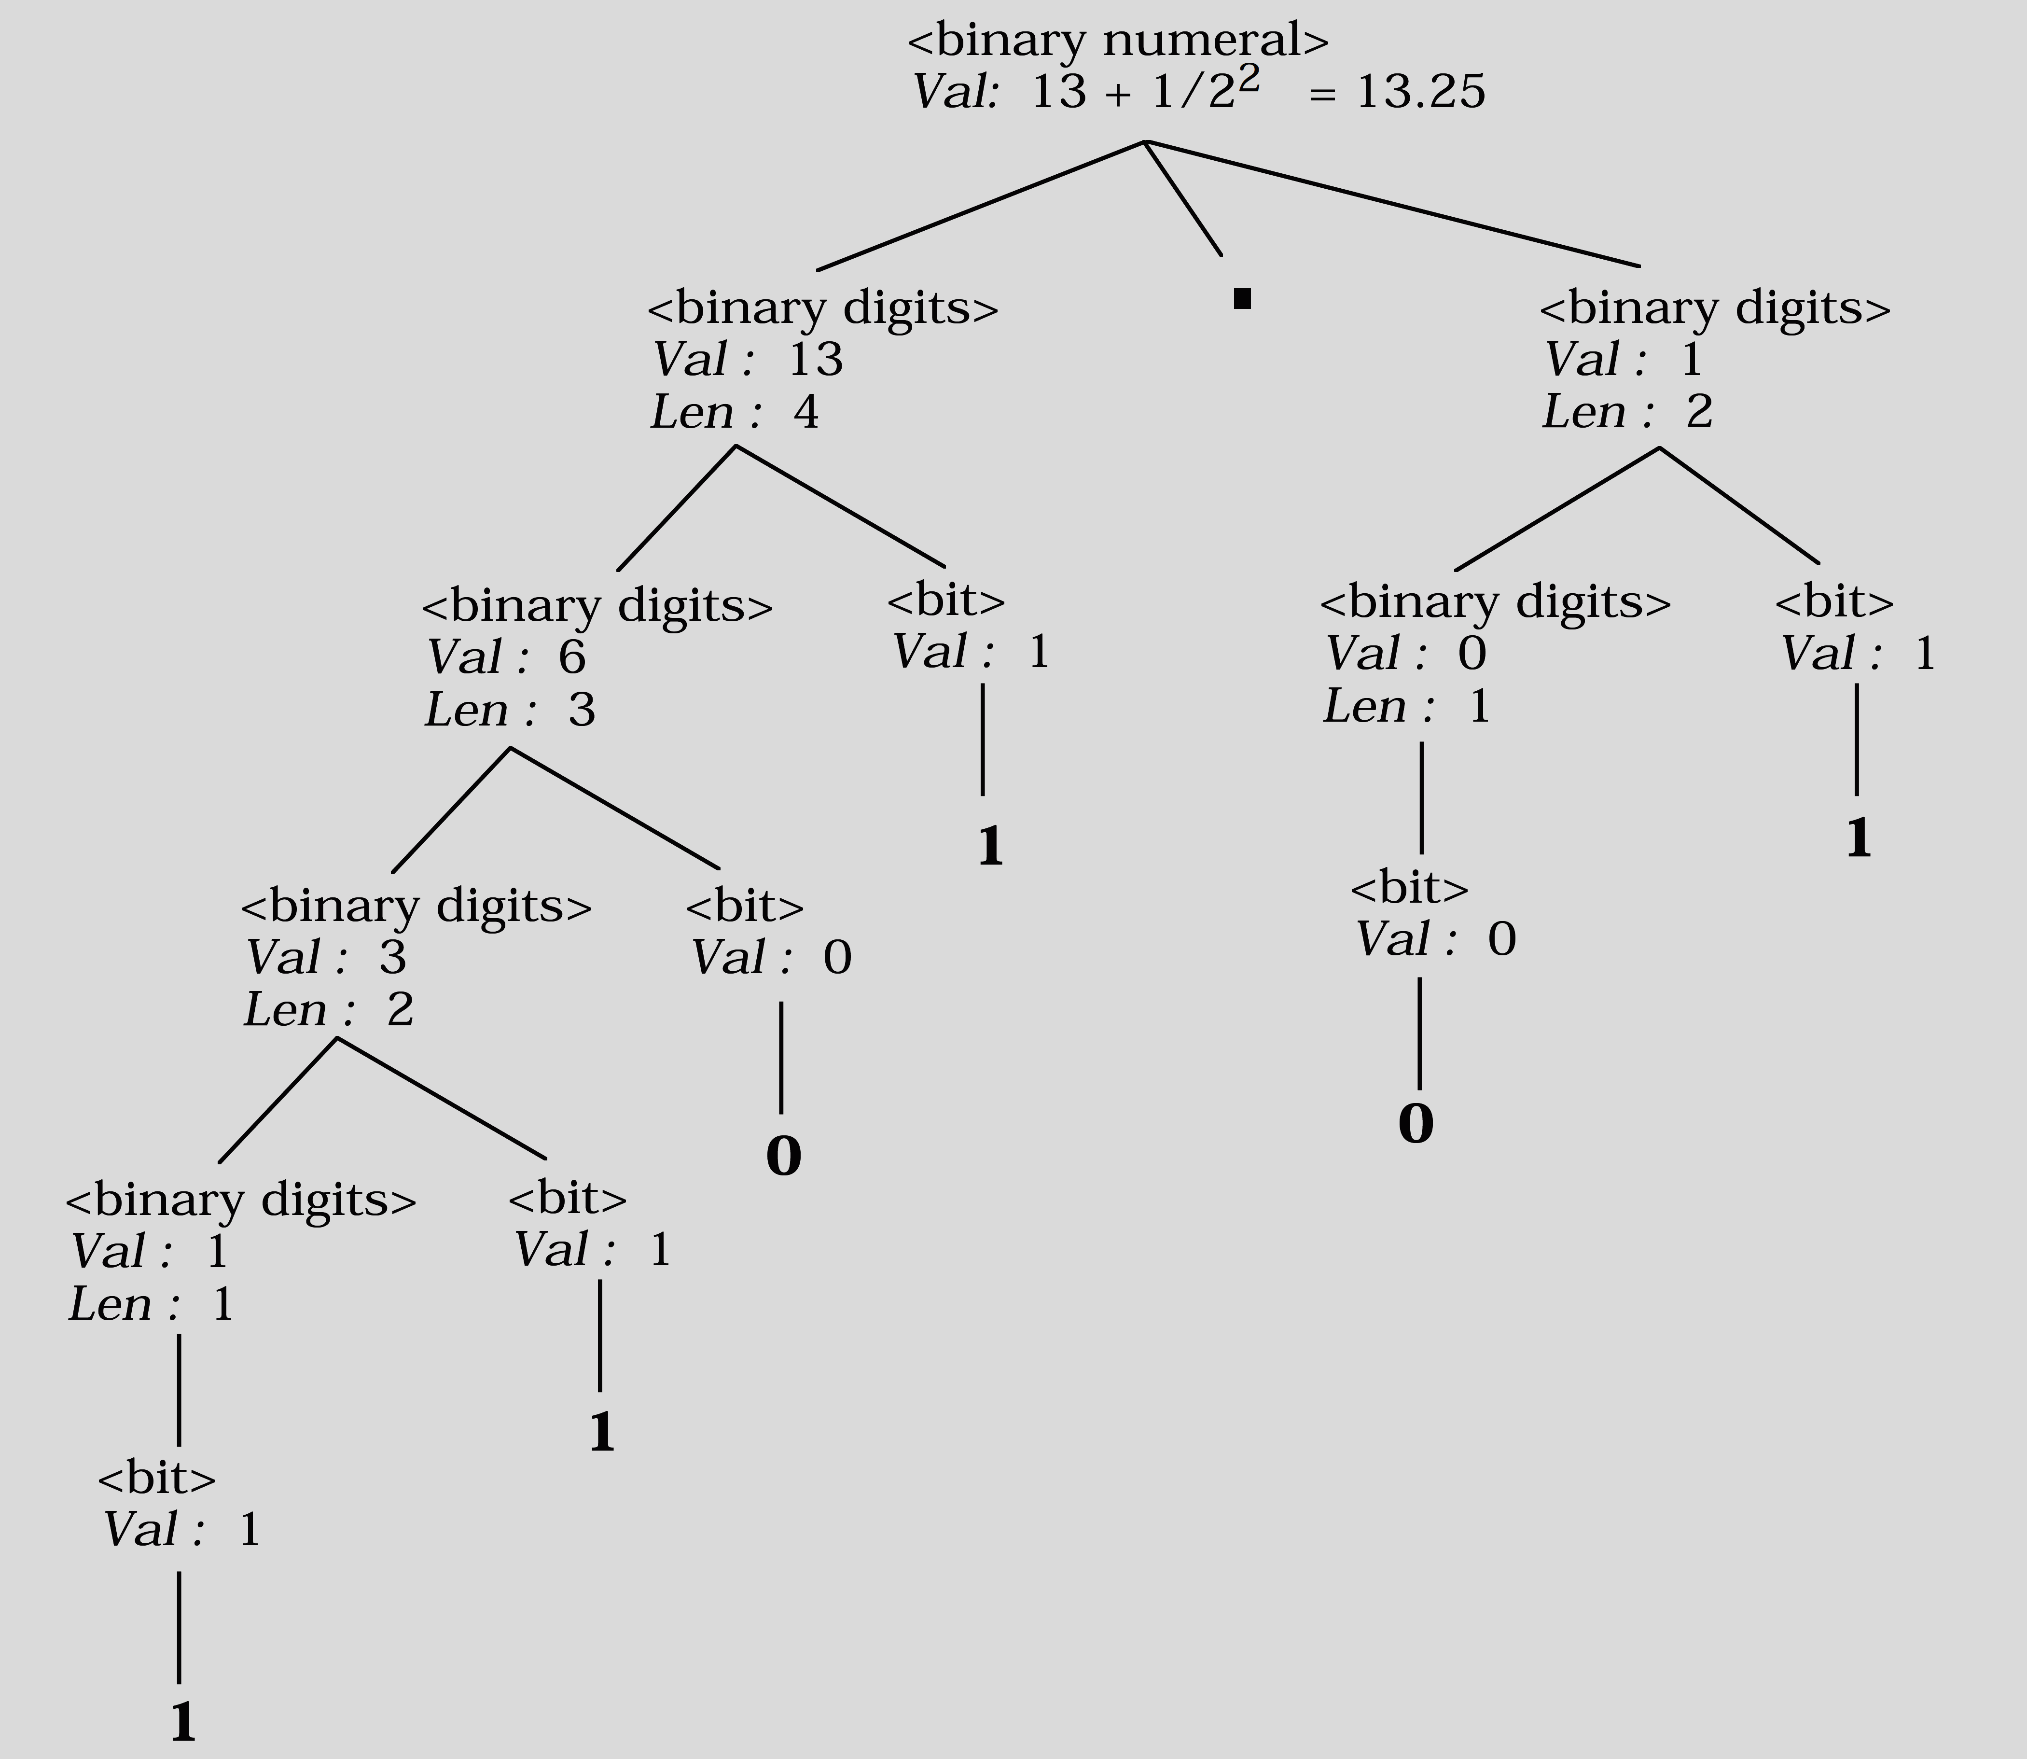
Semantics via …: An Example (Ctd.)
The following derivation tree illustrates the use of attributes that give the semantics for the binary numeral 1101.01.

Slide 14
Semantics via …: An Example (Ctd.)
The previous specification for the semantics of binary numerals was not based on positional information. As a result, the attribute values below the root do not represent the semantic meaning of the digits at the leaves.
We develop a positional semantics in which an inherited attribute called Pos is introduced. It is convenient to separate the sequence of binary digits to the left of the binary point, identified by the nonterminal <binary digits>, from the fractional binary digits to the right of the binary point, identified by the nonterminal <fraction digits>.
We write our grammar in left recursive form, which means that the leftmost binary digit in a sequence of digits is “at the bottom” of the parse tree. For the binary digits to the left of the binary point, we initialize the Pos attribute to zero and increment it by one as we go down the tree structure. This technique provides the correct positional information for the binary digits in the integer part, but a different approach is needed for the fractional binary digits since the exponents from left to right are -1, -2, -3, .... Notice that this exponent information can be derived from the length of the binary sequence of digits from the binary point up to, and including, the digit itself. Therefore we add a length attribute for fractional digits that is transformed into a positional attribute for the individual bit.

Slide 15
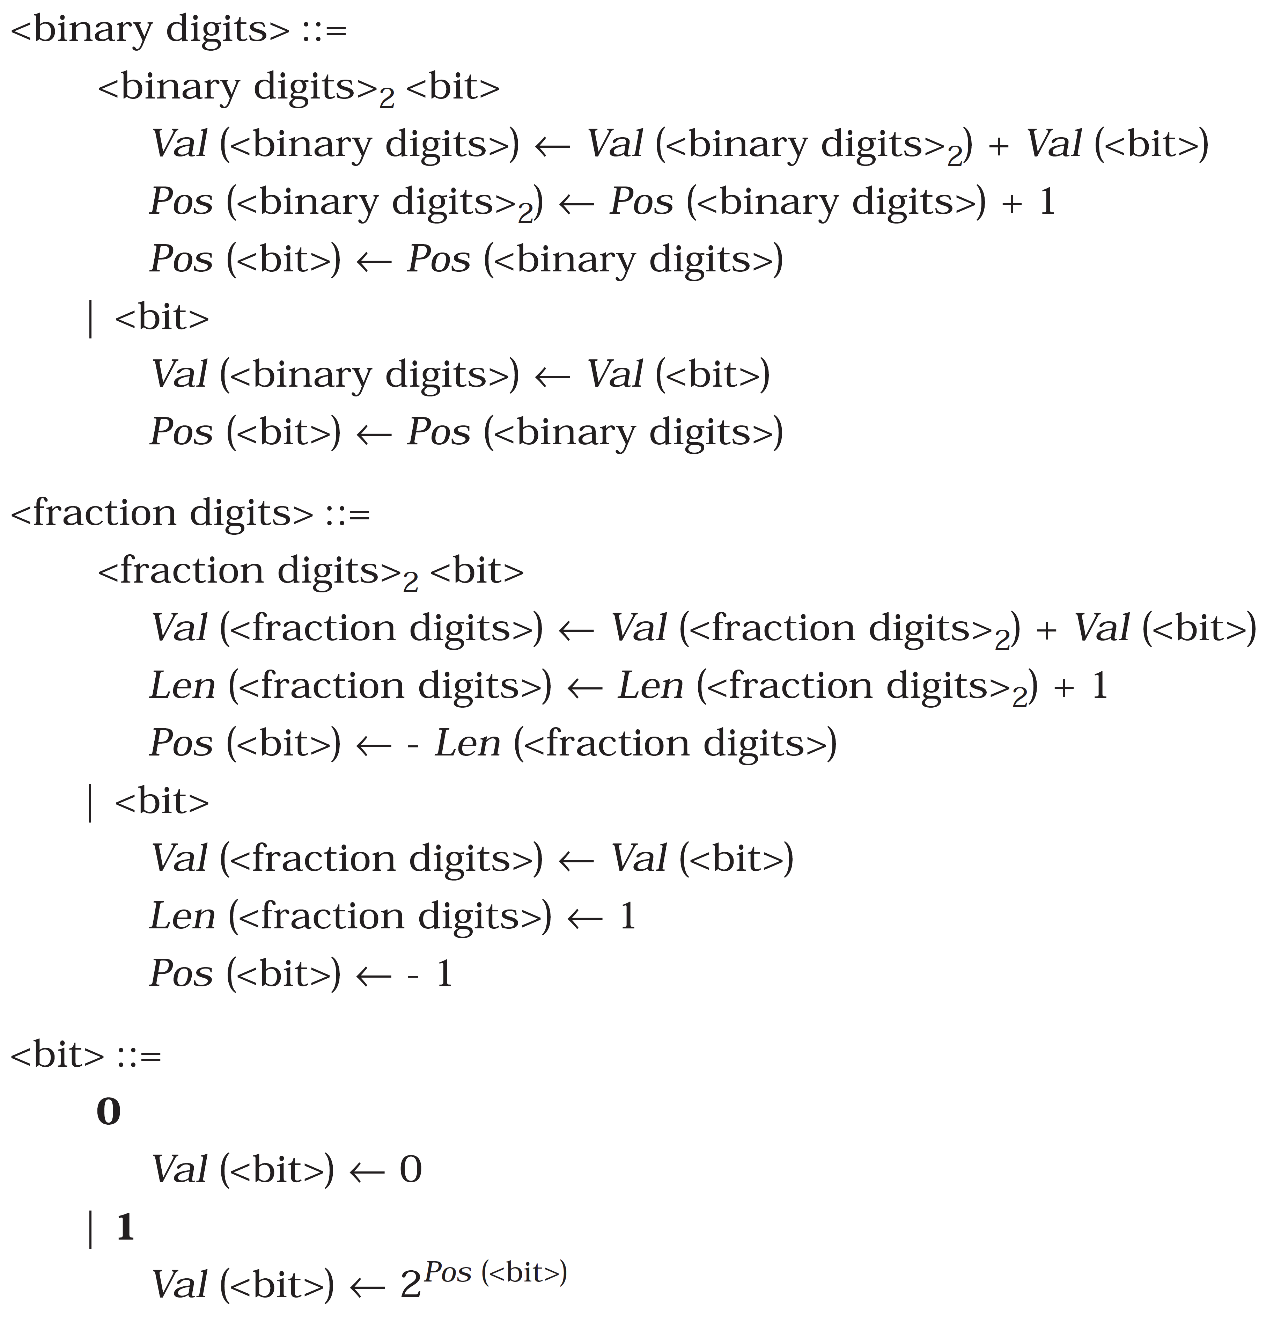
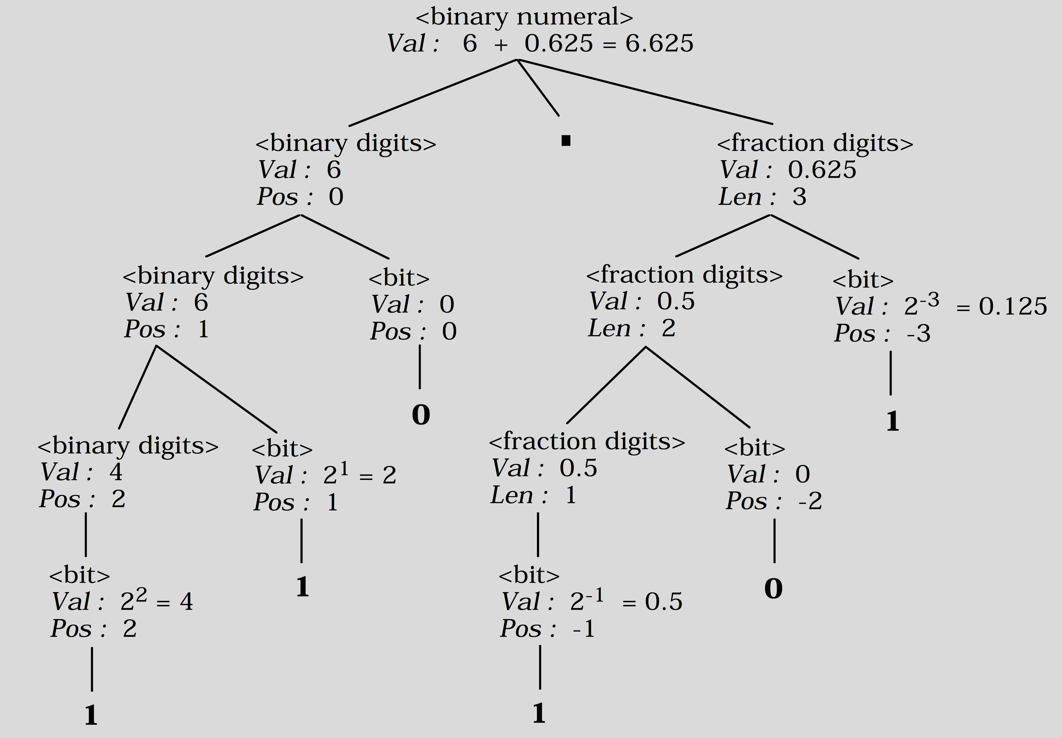
Semantics via …: An Example (Ctd.)
The previous specification for the semantics of binary numerals was not based on positional information. As a result, the attribute values below the root do not represent the semantic meaning of the digits at the leaves.

Slide 16
Scan, Parse, Semantic Analysis
AST Satisfying Context Conditions
Abstract Syntax Tree
Program as Text
(A Sequence of Characters)
A Sequence of Tokens
Syntactic Analyzer
(Parser)
Lexical Analyzer
(Scanner)
Semantic Analyzer)
Lexical Syntax
Phrase-Structure Syntax (BNF)
and
Abstract Syntax
Attribute Grammar, Type System, …

Slide 17
Formal Syntax and Semantics by Kenneth Slonneger and Barry Kurtz
You can find Assignment 1 through http://courses.aut.ac.ir.

